Slide 1
Generating Images with Perceptual Similarity Metrics based on Deep Networks
Alexey Donsovitskiy Thomas Brox
University of Freiburg
NIPS 2016
Haozhe Feng
Sep 16, 2018
Notes:
Unsupervised Feature Learning via Non-Parametric Instance Discrimination

Slide 2
Outline
Which problem does the article focus on.
What is the main idea and the pipeline of the proposed approach.
Some insights and light spots the article brings to us.

Slide 3
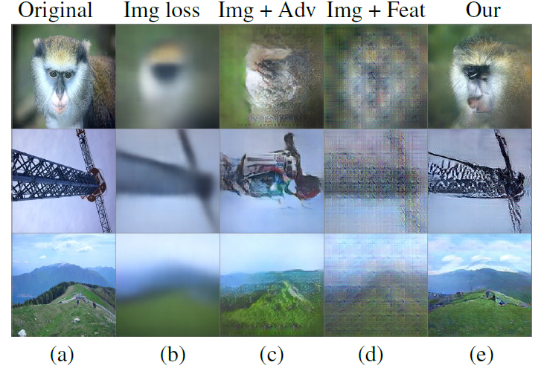
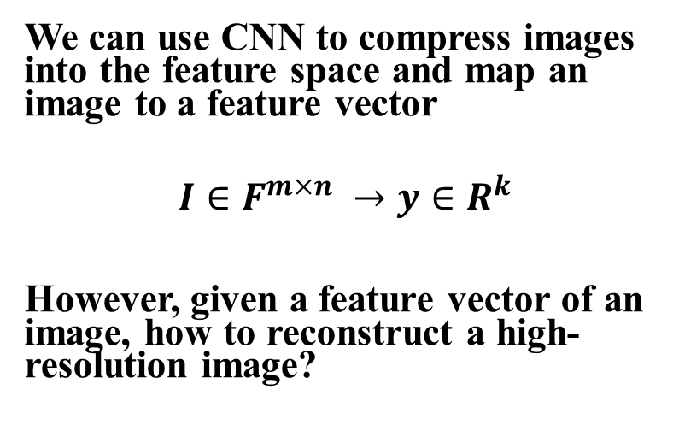
1. Which problem does the article focus on
We can use CNN to compress images into the feature space and map an image to a feature vector
$$I∈F^{m×n} →y∈R^{k}$$
However, given a feature vector of an image, how to reconstruct a high-resolution image?
论文分享 Unsupervised Feature Learning

Slide 4
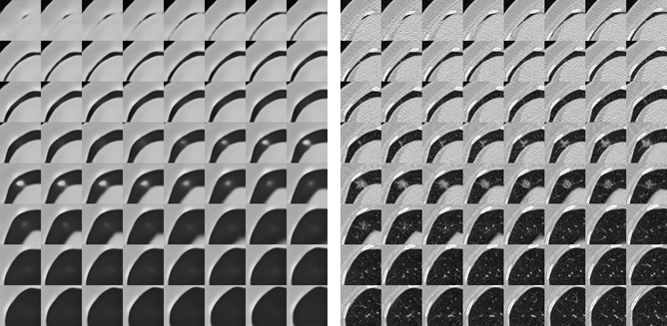
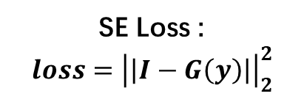
2.What is the main idea of the proposed approach
2.1 The background of the approach
The squared Euclidean(SE) distance always blurry results because the precise location of details is not preserved in feature vector, and the SE loss leads to averaging all likely locations of details
SE Loss :
$$loss={\left|\left|I−G\left(y\right)\right|\right|}_{2}^{2}$$
Note : this figure is the lung nodule construction result of auto encoder from our experiment
论文分享 Unsupervised Feature Learning

Slide 5

2.What is the main idea of the proposed approach
2.2 The pipline of the approach
Given : $(y_{i},x_{i})$, $x_{i}∈R^{W×H×C}$ is the image and $y_{i}∈R^{k}$ is the feature of $x_{i}$ extracted with deep neural network
Target : train an generate $G$ with $loss(G\left(y_{i}\right), x_{i})$, which can generalize to other image features
Step 1: use a pretrained generator to generate $G\left(y_{i}\right)$
Step 2: find a fully trained and differentiable compactor $C:R^{W×H×C}→R^{F}$,calculate feature loss
$$L_{feat}={\left|\left|C\left(G\left(y_{i}\right)\right)−C\left(x_{i}\right)\right|\right|}_{2}^{2}$$
Step 3: find a discriminator $D$, calculate adversarial loss
$$L_{adv}=−log\left(D\left(x_{i}\right)\right)−log(1−D\left(G\left(y_{i}\right)\right)$$
Step 4: do backward with
$$loss=λ_{feat}L_{feat}+λ_{adb}L_{adv}+L_{SE}$$
论文分享 Unsupervised Feature Learning

Slide 6
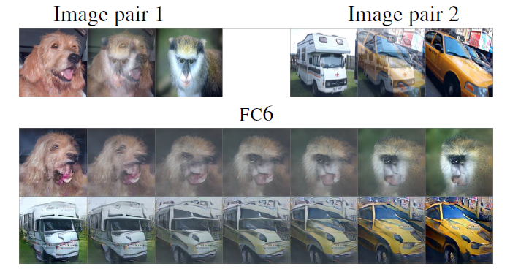
3. Some insights and light spots the article brings to us
Why use feature loss
The Author think that local image statistics are stored in suitable feature space, so the loss in feature space can help the generator reconstruct perceptually important image properties, like salint edges and textures.
How to design experiments
To prove the feature loss and adversarial loss are all important, they do ablation study
Interpolation experiments
论文分享 Unsupervised Feature Learning

Slide 7
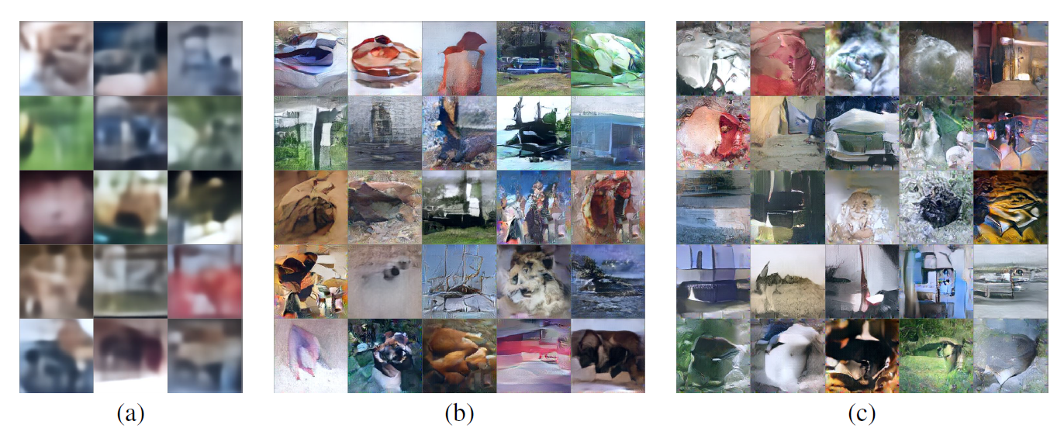
3. Some insights and light spots the article brings to us
How to design experiments
Variational Encoder experiments
How to write an article like this
Package the application
1.show which information is preserved in feature
2.related with real bring encode-decode process
3.can be used in unsupervised learning(Variational Auto Encoder)
Irrelevant but eye-catching title
Perceptual similarity metrics never mentioned in experiments
If lack theoretical support, do experiments
论文分享 Unsupervised Feature Learning

Slide 8
Thanks!

